Slide 1

PYTHON 101
Jon-Cody Sokoll
Data Scientist, Deloitte

Slide 2
ABOUT ME
WECOME!
Here’s a bit about me:
Name: Jon-Cody Sokoll
Background: Rhodes College, American Institutes for Research, Deloitte
Fun Fact: Moonlight bread baker

Slide 3
ABOUT YOU
BEFORE WE DIVE IN…
Let’s talk a bit about you!
Name
What brings you to GA?
Fun Fact
Current activities
Future goals

Slide 4
PYTHON 101
LEARNING OBJECTIVES
Discover the history of Python and how it compares to other programming languages.
Touch on fundamental Python programming techniques and tools.
Discuss its applications in data science and the types of problems it can solve.
See where Python programming fits into the data workflow.
Apply your new skills to solve a real-world problem with Python.

Slide 5
WHAT TOOLS DO DATA SCIENTISTS USE?
WHY PYTHON?
Created for simplicity and readability
Rapid prototyping, ease of production
Open source, importable libraries
Broad range of applications
Fast growing community
Founded by
Guido van Rossum
in 1991

Slide 6
WHAT TOOLS DO DATA SCIENTISTS USE?
ZEN OF PYTHON
Beautiful is better than ugly. Explicit is better than implicit. Simple is better than complex. Complex is better than complicated. Flat is better than nested. Sparse is better than dense. Readability counts. Special cases aren't special enough to break the rules. Although practicality beats purity. Errors should never pass silently. Unless explicitly silenced. In the face of ambiguity, refuse the temptation to guess. There should be one—and preferably only one—obvious way to do it. Although that way may not be obvious at first unless you're Dutch. Now is better than never. Although never is often better than right now. If the implementation is hard to explain, it's a bad idea. If the implementation is easy to explain, it may be a good idea. Namespaces are one honking great idea—let's do more of those!

Slide 7
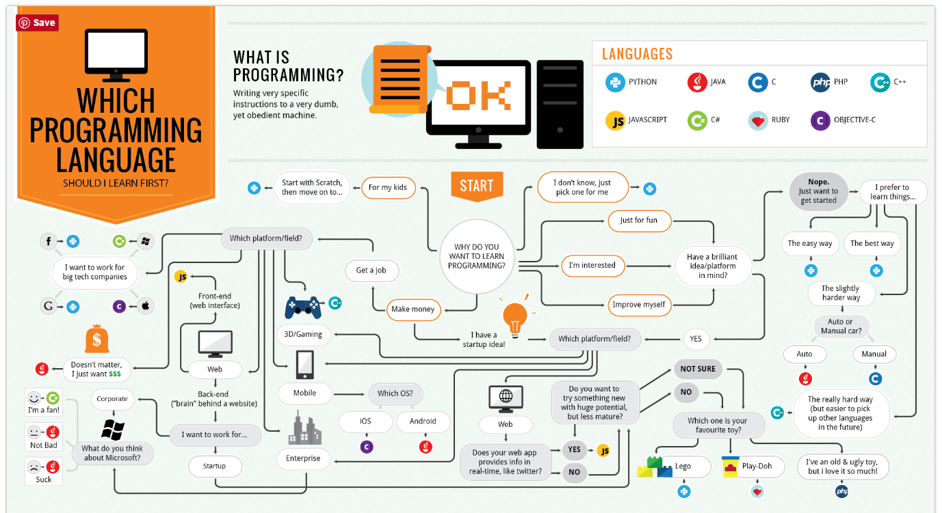
WHY PYTHON?

Slide 8

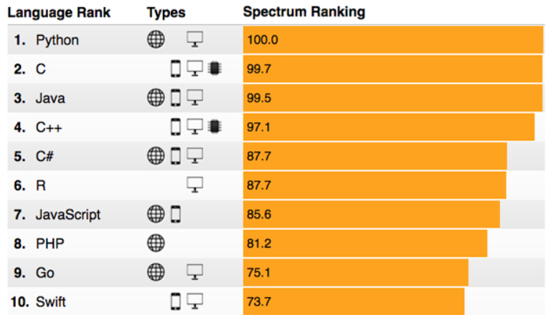
WHY PYTHON?

Slide 9
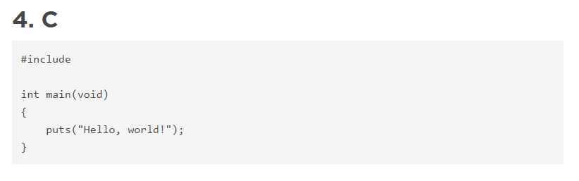
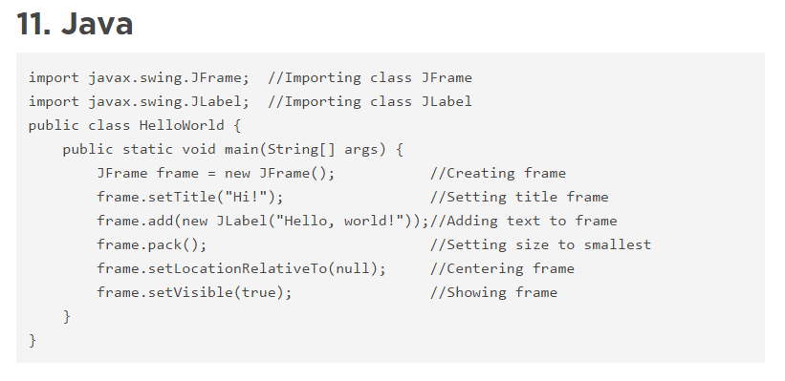
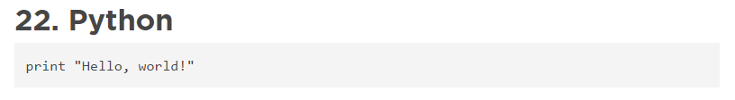
WHY PYTHON?

Slide 10
PYTHON 101
LEARNING OBJECTIVES
Discover the history of Python and how it compares to other programming languages.
Touch on fundamental Python programming techniques and tools.
Discuss its applications in data science and the types of problems it can solve.
See where Python programming fits into the data workflow.
Apply your new skills to solve a real-world problem with Python.

Slide 11
PYTHON 101
LEARNING OBJECTIVES
Discover the history of Python and how it compares to other programming languages.
Touch on fundamental Python programming techniques and tools.
Discuss its applications in data science and the types of problems it can solve.
See where Python programming fits into the data workflow.
Apply your new skills to solve a real-world problem with Python.

Slide 12
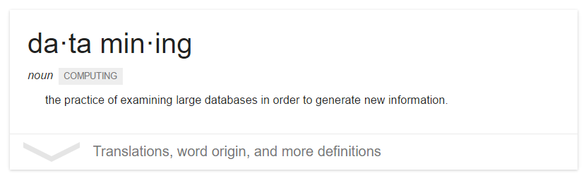
WHAT IS A DATA SCIENTIST?
MY DEFINITION
Data Scientists use data mining techniques to generate new insights that increase efficiencies / give businesses a competitive advantage
Problem
Domain
Computer Science
Statistics

Slide 13
WHAT IS A DATA SCIENTIST?
Data
Warehousing
Business
Domain
Visualization
Programming
Statistics
Machine
Learning

Slide 14
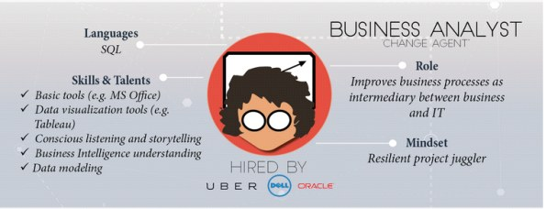
WHAT IS A DATA SCIENTIST?
ROLE:

Slide 15

WHAT IS A DATA SCIENTIST?
Data
Warehousing
Business
Domain
Visualization
Programming
Statistics
Machine
Learning

Slide 16
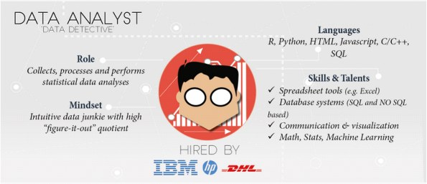
WHAT IS A DATA SCIENTIST?
ROLE:

Slide 17

WHAT IS A DATA SCIENTIST?
Data
Warehousing
Business
Domain
Visualization
Programming
Statistics
Machine
Learning

Slide 18
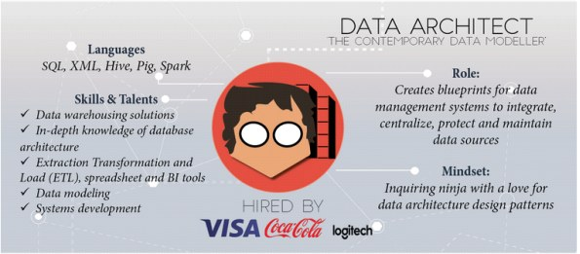
WHAT IS A DATA SCIENTIST?
ROLE:

Slide 19

WHAT IS A DATA SCIENTIST?
Data
Warehousing
Business
Domain
Visualization
Programming
Statistics
Machine
Learning

Slide 20
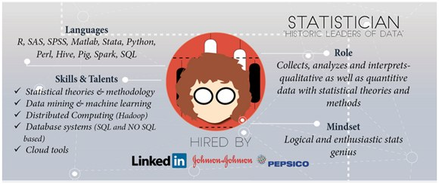
WHAT IS A DATA SCIENTIST?
ROLE:

Slide 21

WHAT IS A DATA SCIENTIST?
Data
Warehousing
Business
Domain
Visualization
Programming
Statistics
Machine
Learning

Slide 22
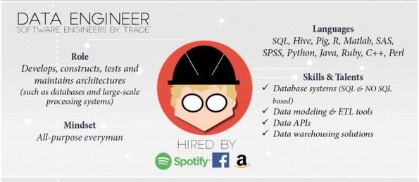
WHAT IS A DATA SCIENTIST?
ROLE:

Slide 23

WHAT IS A DATA SCIENTIST?
Data
Warehousing
Business
Domain
Visualization
Programming
Statistics
Machine
Learning

Slide 24
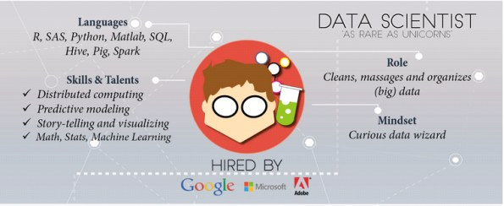
WHAT IS A DATA SCIENTIST?
ROLE:

Slide 25

WHAT IS A DATA SCIENTIST?
Data
Warehousing
Business
Domain
Visualization
Programming
Statistics
Machine
Learning

Slide 26
WHAT IS A DATA SCIENTIST?
Data
Warehousing
Business
Domain
Visualization
Programming
Statistics
Machine
Learning

Slide 27
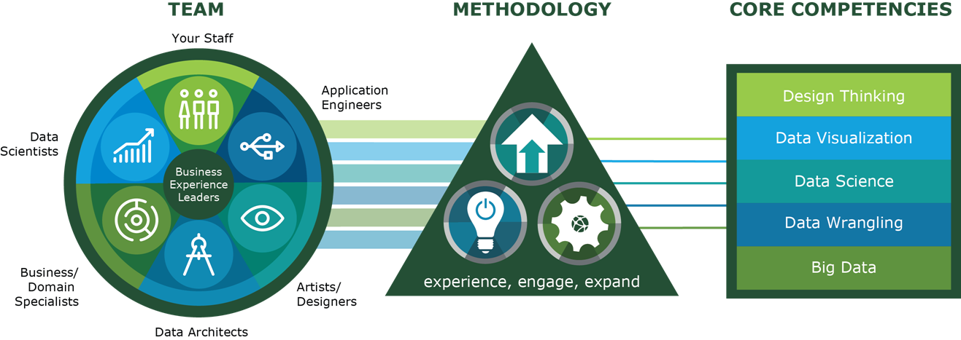


WHO DO DATA SCIENTISTS WORK WITH?
TEAM

Slide 28
HOW DO DATA SCIENTISTS ADD VALUE?
VALUE ADD
Predicting the bad
Identifying the good
Automating existing processes
Categorical
Continuous
Supervised
Classification
Regression
Unsupervised
Clustering
Dimension Reduction

Slide 29
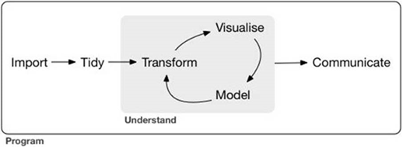
WHAT IS THE DATA SCIENCE WORKFLOW?
WORKFLOW
Define the problem / question
Identify and collect data
Explore and prepare data
Build and evaluate model
Communicate results

Slide 30


WHAT TOOLS DO DATA SCIENTISTS USE?
KEY TOOLS
Querying /
Collection
Database Queries
Web Scraping
API Calls

Slide 31

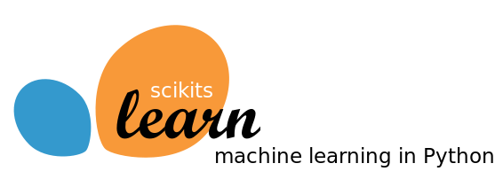
WHAT TOOLS DO DATA SCIENTISTS USE?
KEY TOOLS
Querying /
Collection
Manipulation / Modeling
Database Queries
Web Scraping
API Calls
Munging and wrangling
Merging and enhancing
Building Models

Slide 32
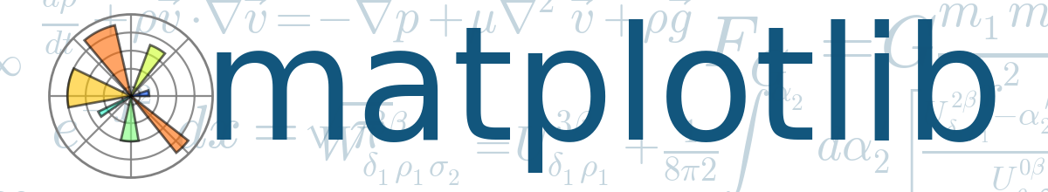

WHAT TOOLS DO DATA SCIENTISTS USE?
KEY TOOLS
Querying /
Collection
Manipulation / Modeling
Exploration / Visualization
Database Queries
Web Scraping
API Calls
Munging and wrangling
Merging and enhancing
Building Models
Exploratory analysis
Plotting and graphing
Dashboard creation

Slide 33










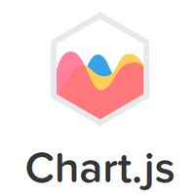

WHAT TOOLS DO DATA SCIENTISTS USE?
OTHER TOOLS
Querying /
Collection
Manipulation / Modeling
Exploration / Visualization
Database Queries
Web Scraping
API Calls
Munging and wrangling
Merging and enhancing
Building Models
Exploratory analysis
Plotting and graphing
Dashboard creation

Slide 34
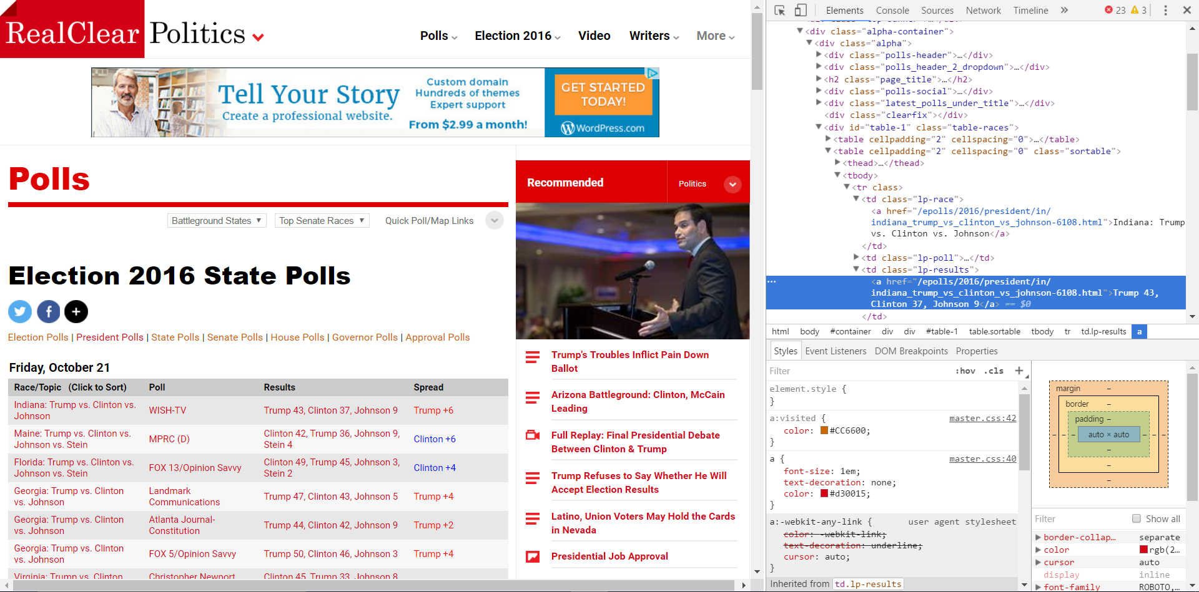
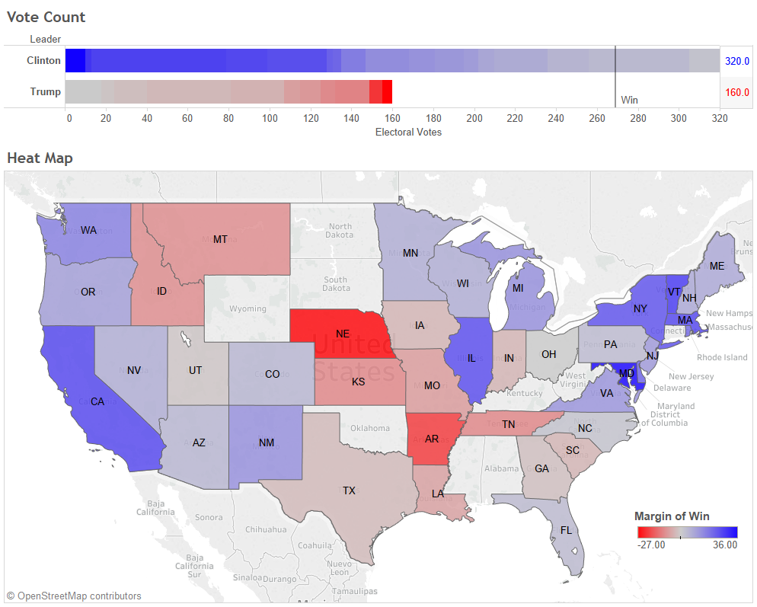
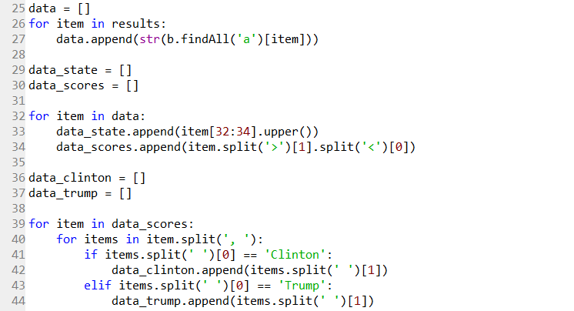
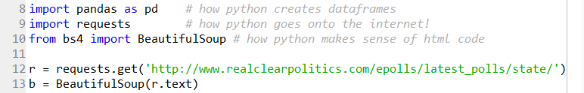
WHAT TOOLS DO DATA SCIENTISTS USE?
EXAMPLE PROJECT
Querying /
Collection
Manipulation / Modeling
Exploration / Visualization
Web Scraping
Munging and wrangling
Dashboard creation

Slide 35
PYTHON 101
CODING

Slide 36
PYTHON 101
Q & A

Slide 37
PYTHON 101
LEARNING OBJECTIVES
Discover the history of Python and how it compares to other programming languages.
Touch on fundamental Python programming techniques and tools.
Discuss its applications in data science and the types of problems it can solve.
See where Python programming fits into the data workflow.
Apply your new skills to solve a real-world problem with Python.

Slide 38
PYTHON 101
CODING

